Slide 1
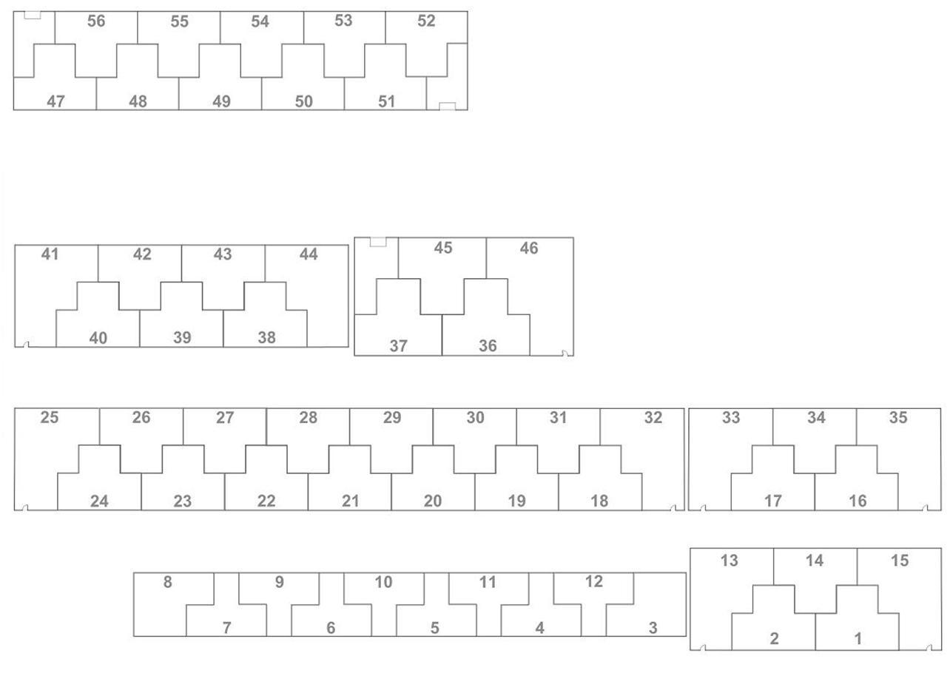
T-Hangar Sizes and Rates
(Rates as of 7/1/2025 - Res. No. 133)
A. $146.00 a month (No longer renting)
Slide Door Width – 39’ 9”
Depth – 31’ 4”
Tail Width – 12’ 5”
*Hangar #3 & #8 offers extra storage space
B. $182.00 a month (24 available - #’s 1,2,14,16,17-24,26-31,34,38-40,42,43)
Electric Bi-Fold Door Width – 41’ 6”
Depth – 32’
Tail Width – 20’ 6”
Height Clearance – 11’ 11”
C. $203.00 a month (8 available - #’s 13,15,25,32,33,35,41,44)
End T-Hangars
Dimensions – Same As Above
*Each Hangar offers extra storage space
D. $233.00 a month (10 available - #’s 47-56)
Electric Bi-Fold Door Width – 42’
Depth – 33’
Height Clearance – 12’
E. $242.00 a month(4 available - #’s 36,37,45,46)
Electric Bi-Fold Door Width – 43’ 6”
Depth – 38’
Tail Width – 21’ 7”
Height Clearance – 13’ 11”
*Hangar #46 offers extra storage space
W. Check waiting list prior to re-renting
South T-Hangars – 47-56
Southwest Facing Side
LEASED
LEASED
LEASED
LEASED
LEASED
D
D
D
LEASED
LEASED
LEASED
D
LEASED
W
W
LEASED
W
W
W
D
D
D
D
D
East T-Hangars – 1-46
North Facing Side
North Facing Side
LEASED
LEASED
LEASED
LEASED
LEASED
LEASED
C
B
B
C
E
E
LEASED
LEASED
LEASED
LEASED
LEASED
B
W
B
W
B
W
E
W
E
W
W
LEASED
North Facing Side
LEASED
LEASED
North Facing Side
LEASED
LEASED
LEASED
LEASED
LEASED
LEASED
LEASED
LEASED
C
B
B
B
C
C
B
C
LEASED
LEASED
LEASED
LEASED
W
LEASED
LEASED
LEASED
LEASED
LEASED
B
B
B
B
W
W
W
W
B
B
W
B
W
B
W
B
North Facing Side
North Facing Side
LEASED
C
LEASED
B
C
LEASED
Not Available
Not Available
Not Available
Not Available
Not Available
LEASED
A
Not Available
Not Available
Not Available
Not Available
Not Available
LEASED
A
B
W
B
W
W
Current as of 7/1/2025

